Slide 1

Cross-Platform Apps for Web & Mobile with AngularJS and Cordova

Slide 2


Alex Casquete
Software Developer at Plain Concepts
acasquete@plainconcepts.com
@acasquete

Slide 3
Talking Points
Modern application
Target architecture
Web-based application technologies
Web going native

Slide 4
Modern Applications
Cross platform != Mobile
Mobile != Phones & Tablets

Slide 5
The ‘Continuous Screen’
Today: focus on mobile devices & apps
But what is mobile?
From a small phone to a large phone to a small Tablet to a large tablet to a small desktop…
We need UX & technologies to realize the Continuous screen
Adaptive user interfaces with optimized user experience
With one code base & target architecture

Slide 6
The ‘Continuous Screen’
Develop a single underlying system that allows for a unified experience across platforms and device sizes.

Slide 7
Write once, run anywhere

Slide 8
Technology stack
Request/response: Lightweight Web/HTTP APIs
ASP.NET Web API
Bi-directional: Push Services
ASP.NET SignalR
Token-based security
Token & authorization servers
Ubiquituous clients
Web-based application technologies

Slide 9
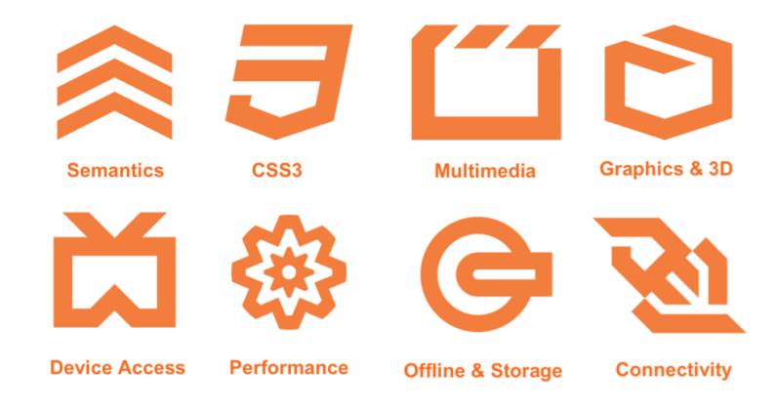
HTML5 as a Platform
HTML5 ~= Semantic markup + CSS3 + Javascript
An application development platform

Slide 10
JavaScript + Markup + CSS3
JavaScript as application language
Optionally TypeScript
AngularJS as application framework: MVVM
Alternatives like ReactJS, EmberJS, KnockoutJS
Templating frameworks for building views
AngularJS has built-in templating
Ionic or Bootstrap as common-base layout system
More app-like UX frameworks like WinJS

Slide 11
What is Ionic?
A Front-end framework for mobile apps
Contains a lot of mobile-optimized HTML, CSS and JS components
Best Friend with AngularJs
Uses Cordova to create, build, run, deploy mobile apps

Slide 12

What is Ionic?
Ionic solves multiple device resolution issues

Slide 13

Ionic Templates
Ionic start app blank
Ionic start app tabs
Ionic start app sidemenu

Slide 14
I didn’t know that!
We can build large-scale application with JavaScript
We can have IntelliSense with JavaScript
We can debug & profile JavaScript
We can use JavaScript for real-time 3D
JavaScript slowly gets near-native in perfomance
We can have a fresh look at JavaScript
Upcoming ECMAScript6 is a big leap forward

Slide 15
MVVM with AngularJS
AngularJS is a client-side JavaScript SPA framework
Tries to take away complexities
Tries to prepare the way for ECMAScript6
Tries to prepare the way for Web Components
Focus on separation of concertns with patterns
Dependency injection
Models
Views
ViewModels
Notes:
Web Components are a set of standards currently being produced by Google engineers as a W3C specification that allow for the creation of reusable widgets or components in web documents and web applications. The intention behind them is to bring component-based software engineering to the World Wide Web.

Slide 16
Web going native Use the best from both worlds
.

Slide 17
Cross-Platform Apps for Web & Mobile with AngularJS and Cordova
Cross platform != Mobile, and Mobile != Phones/Tablets
HTML/JavaScript-based frameworks like AngularJS enable real applications
Cordova offers platform & tools for native integration & deployment

Slide 18
Questions?

Slide 19
Alex Casquete
Software Developer at Plain Concepts
acasquete@plainconcepts.com
@acasquete

Slide 20
Resources
Visual Studio Multi-Device Hybrid Apps http://www.visualstudio.com/en-us/explore/cordova-vs.aspx
Cordova
http://cordova.apache.org/
AngularJS
https://angularjs.org/
ng-cordova
http://ngcordova.com/

